Slide 1


<Name>
<Date>

Slide 2

Outline
Executive Summary
Introduction
Methodology
Results
Conclusion
Appendix

Slide 3
Executive Summary
Summary of methodologies
Data collection using the space X API and web scrapping using Beautiful soup library from python.
Data wrangling using pandas to clean the data, drop non falcon9 booster versions and remove missing numbers.
Analyze the data using pandas library and sql database
Use MatPlotlib, seaborne, pandas to visualize and discover relationships between features
Use folium and potly to design interactive visualization and dash board.
Summary of all results
The model performed well on the test data with an accuracy score 83% predicting the whether the space mission will be a success .

Slide 4
Introduction
Space X advertises Falcon 9 rocket launches on its website with a cost of 62 million dollars; other providers cost upward of 165 million dollars each, much of the savings is because Space X can reuse the first stage.
Therefore if we can determine if the first stage will land, we can determine the cost of a launch. This information can be used if an alternate company wants to bid against space X for a rocket launch.
Therefore we can use models to predict whether a mission launch will be successful or not.
Therefore if we can determine if the first stage will land, we can determine the cost of a launch. This information can be used if an alternate company wants to bid against Space X for a rocket launch

Slide 5

Section 1

Slide 6
Methodology
Executive Summary
Data collection methodology:
Date was collected using the get request to the Space X APL and web scrapping using beautiful soup
Perform data wrangling
Data was modified by removing missing values and replacing them with mean and then remained with Falcon9 as the booster version only.
Perform exploratory data analysis (EDA) using visualization and SQL
Perform interactive visual analytics using Folium and Plotly Dash
Perform predictive analysis using classification models
One hot encoding was performed to make categorical data numerical and a class was assigned to the data frame.

Slide 7
Data Collection
Data set were collected using two data collection methods
SpaceX API
Web-Scraping

Slide 8
Data Collection – SpaceX API
1. Spacex URL
2. Response using get request function
3. Print response content
4. Static response object to get json documents
https://github.com/artpet19/SpaceX-Falcon9-Launch-and-Landing-Predictor/blob/3f2eea93f7dd5b9b04c4915e769de90be3edc680/jupyter-labs-spacex-data-collection-api.ipynb

Slide 9
Data Collection - Scraping
1. Data was scrapped from a snapshot of the List of Falcon9 and Falcon Heavy launches Wikipage updated on 9th June 2021 as a static url
2. Use requests. Get() method with the provided static url
3. Create a beautiful soup object from the html response
Print the title
4. Extract columns and variables from table headers
https://github.com/artpet19/SpaceX-Falcon9-Launch-and-Landing-Predictor/blob/3f2eea93f7dd5b9b04c4915e769de90be3edc680/jupyter-labs-webscraping%20(1).ipynb

Slide 10
Data Wrangling
Read csv fail into data frame
Find the missing values
Find the data types
Calculate the number of launches from the launch sites
Calculate the number of launch occurrences in each orbit
Calculate the landing outcomes whether they are success or failures
Calculate the average space mission launches
https://github.com/artpet19/SpaceX-Falcon9-Launch-and-Landing-Predictor/blob/3f2eea93f7dd5b9b04c4915e769de90be3edc680/labs-jupyter-spacex-Data%20wrangling%20(1).ipynb

Slide 11
EDA with Data Visualization
The following charts were plotted
How the Flight Number (indicating the continuous launch attempts.) and Payload variables would affect the launch outcome using a cat plot and scatter plot. As the flight number increases, the first stage is more likely to land successfully. The payload mass is also important; the more massive the payload, the less likely the first stage will return.
Visually check if there are any relationship between success rate and orbit type using a bar chart.
For each orbit, to see if there is any relationship between Flight Number and Orbit type using a scatter plot
Payload vs. Orbit scatter point charts to reveal the relationship between Payload and Orbit type.
A line chart to show a trend of success rate in different years.
https://github.com/artpet19/SpaceX-Falcon9-Launch-and-Landing-Predictor/blob/3f2eea93f7dd5b9b04c4915e769de90be3edc680/edadataviz.ipynb

Slide 12
EDA with SQL
SQL queries you performed
Display the names of the unique launch sites in the space mission
Display 5 records where launch sites begin with the string 'CCA‘
Display the total payload mass carried by boosters launched by NASA (CRS)
Display average payload mass carried by booster version F9 v1.1
List the date when the first successful landing outcome in ground pad was achieved.
List the names of the boosters which have success in drone ship and have payload mass greater than 4000 but less than 6000
List the total number of successful and failure mission outcomes
List the names of the booster versions which have carried the maximum payload mass. Use a subquery
List the records which will display the month names, failure landing outcomes in drone ship ,booster versions, launch site for the months in year 2015.
Rank the count of landing outcomes (such as Failure (drone ship) or Success (ground pad)) between the date 2010-06-04 and 2017-03-20, in descending order.
https://github.com/artpet19/SpaceX-Falcon9-Launch-and-Landing-Predictor/blob/3f2eea93f7dd5b9b04c4915e769de90be3edc680/jupyter-labs-eda-sql-coursera_sqllite.ipynb

Slide 13
Build an Interactive Map with Folium
Circles were used to add a highlighted circle area with a text label on a launch site
Markers were used to locate a coordinate on the map
Marker Clusters were used to store markers colors based on the class value.
Marker colors were used to separate success and failed launches
Mouse positions were added to get a coordinate for a mouse over a point on the map.
Polyline to show the distance between the launch site and the proximity for example a railway
https://github.com/artpet19/SpaceX-Falcon9-Launch-and-Landing-Predictor/blob/3f2eea93f7dd5b9b04c4915e769de90be3edc680/lab_jupyter_launch_site_location.ipynb

Slide 14
Build a Dashboard with Plotly Dash
An app layout
A title
A dropdown to have all launch site
A pie chart to show the success count rate per launch site and all sites
A Slider to show the pay load mass in Kilograms ranges
A scatter chart to show the correlation between payload and launch success
https://github.com/artpet19/SpaceX-Falcon9-Launch-and-Landing-Predictor/blob/3f2eea93f7dd5b9b04c4915e769de90be3edc680/spacex_dash_app.py

Slide 15
Predictive Analysis (Classification)
Standardized the data using Standard Scalar and transformed
Split the data into training and testing
The model were improved using Grid Search Cross validation
Use the Hyper parameter for SVM, Classification Trees and Logistic Regression
Use a confusion matrix to see the performance of the model predictions
Calculate the accuracy using the score method on the test data on each model.
Get the model that performs best using the test data
https://github.com/artpet19/SpaceX-Falcon9-Launch-and-Landing-Predictor/blob/3f2eea93f7dd5b9b04c4915e769de90be3edc680/SpaceX_Machine%20Learning%20Prediction_Part_5.ipynb

Slide 16
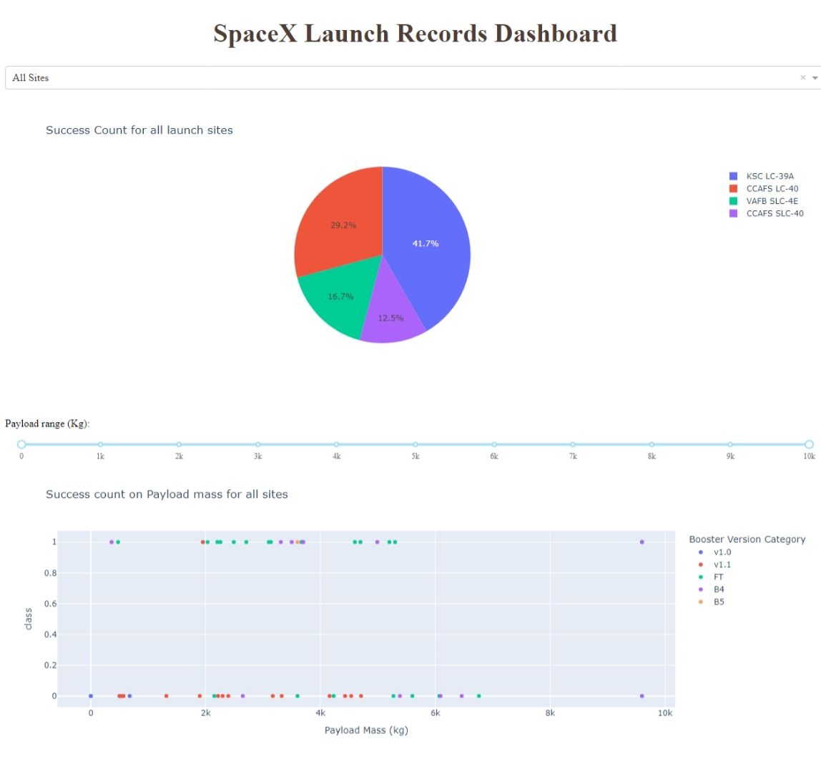
Results
Exploratory data analysis results
There is a relationship among Flight Number and Payload variables and how they affect the launch outcome
As the flight number increases, the first stage is more likely to land successfully. The payload mass is also important; the more massive the payload, the less likely the first stage will return.
Interactive analytics demo in screenshots
An interactive dashboard was created that represents relationships between success count rate, launch site and pay load mass.
Predictive analysis results
All the models performed well on the test data with an accuracy of 83%

Slide 17

Section 2

Slide 18
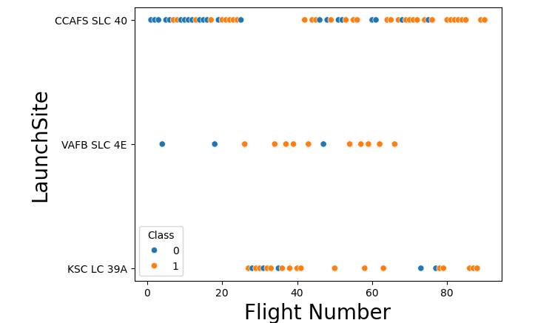
Flight Number vs. Launch Site
Explanation:
There is no correlation between the success rate with the number of flight at CCAFS SLC 40 and KSC LC 39A launching sites.
For Launch site VAFB SLC 4E, the success rate increased with the number of flights.

Slide 19
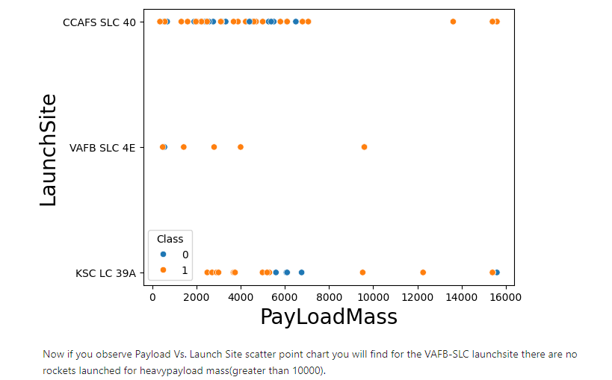
Payload vs. Launch Site
Explanation:
Now if you observe Payload Vs. Launch Site scatter point chart you will find for the VAFB-SLC launch site there are no rockets launched for heavy payload mass(greater than 10000).

Slide 20
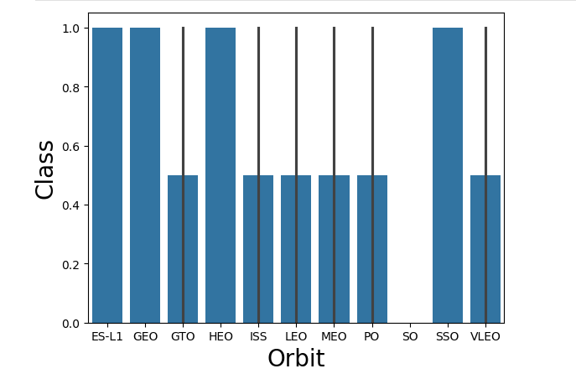
Success Rate vs. Orbit Type
Explanation:
Falcons launched in the ES-L1, GEO, HEO, SSO Orbits have a high success rate as compared to those launched in the GTO, ISS, LEO, MEO, PO,VLEO which have a low success rate

Slide 21
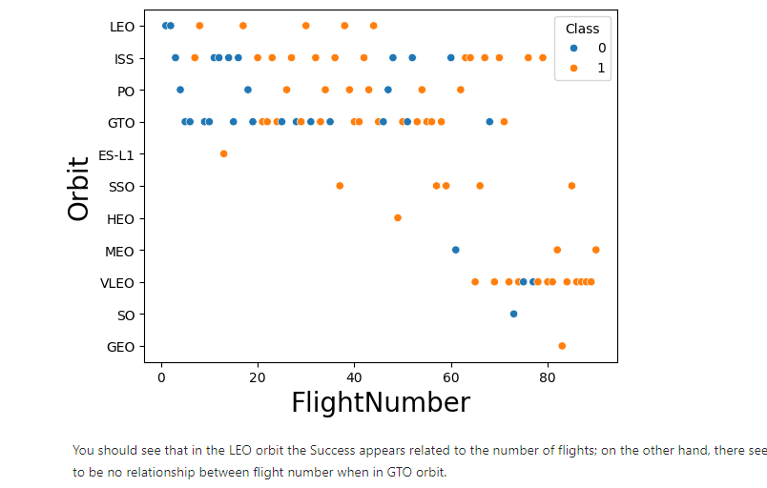
Flight Number vs. Orbit Type
Explanation:
In the LEO orbit the Success appears related to the number of flights; on the other hand, there seems to be no relationship between flight number when in GTO orbit.

Slide 22
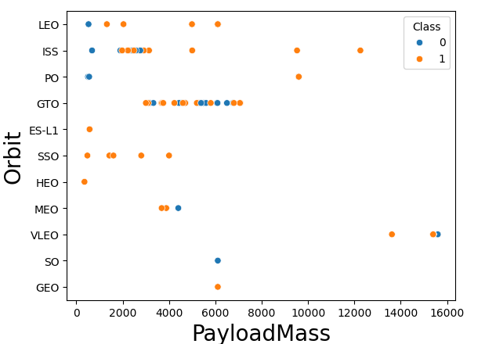
Payload vs. Orbit Type
Explanation:
With heavy payloads the successful landing or positive landing rate are more for and ISS.
However for GTO we cannot distinguish this well as both positive landing rate and negative landing(unsuccessful mission) are both there here.

Slide 23
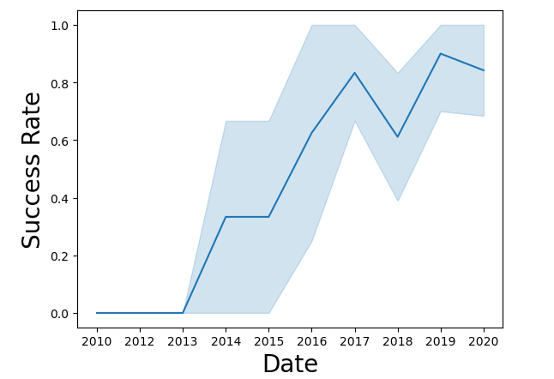
Launch Success Yearly Trend
Explanation:
The general trend in success rate has been increasing since inception however the success rate since 2013 kept increasing till 2020 significantly.

Slide 24
All Launch Site Names
There are four launching sites that participated in the space mission namely;
Launch Site
CCAFS LC-40
VAFB SLC-4E
KSC LC-39A
CCAFS SLC-40

Slide 25
Launch Site Names Begin with 'CCA'
Below is a table showing the first five records of Launching Sites starting with “CCA”.
Date | Time (UTC) | Booster_Version | Launch_Site | Payload | PAYLOAD_MASS__KG_ | Orbit | Customer | Mission_Outcome | Landing_Outcome
2010-06-04 | 18:45:00 | F9 v1.0 B0003 | CCAFS LC-40 | Dragon Spacecraft Qualification Unit | 0 | LEO | SpaceX | Success | Failure (parachute)
2010-12-08 | 15:43:00 | F9 v1.0 B0004 | CCAFS LC-40 | Dragon demo flight C1, two CubeSats, barrel of Brouere cheese | 0 | LEO (ISS) | NASA (COTS) NRO | Success | Failure (parachute)
2012-05-22 | 7:44:00 | F9 v1.0 B0005 | CCAFS LC-40 | Dragon demo flight C2 | 525 | LEO (ISS) | NASA (COTS) | Success | No attempt
2012-10-08 | 0:35:00 | F9 v1.0 B0006 | CCAFS LC-40 | SpaceX CRS-1 | 500 | LEO (ISS) | NASA (CRS) | Success | No attempt
2013-03-01 | 15:10:00 | F9 v1.0 B0007 | CCAFS LC-40 | SpaceX CRS-2 | 677 | LEO (ISS) | NASA (CRS) | Success | No attempt

Slide 26
Total Payload Mass
The total payload carried by boosters from NASA is zero
SUM(PAYLOAD_MASS__KG_)
None

Slide 27
Average Payload Mass by F9 v1.1
The average payload mass carried by booster version F9 v1.1 is 2928.4 Kg
AVG(PAYLOAD_MASS__KG_)
2928.4

Slide 28
First Successful Ground Landing Date
The dates of the first successful landing outcome on ground pad was the 22nd of December the year 2015.
MIN(Date)
2015-12-22

Slide 29
Successful Drone Ship Landing with Payload between 4000 and 6000
The following is a list of the names of boosters which have successfully landed on drone ship and had payload mass greater than 4000 but less than 6000.
Booster_Version
F9 FT B1022
F9 FT B1026
F9 FT B1021.2
F9 FT B1031.2

Slide 30
Total Number of Successful and Failure Mission Outcomes
The total number of successful and failure mission outcomes was 99
COUNT(Mission_Outcome)
99

Slide 31
Boosters Carried Maximum Payload
The following is a list of names of the booster versions which have carried the maximum payload mass
Booster_Version
F9 B5 B1048.4
F9 B5 B1049.4
F9 B5 B1051.3
F9 B5 B1056.4
F9 B5 B1048.5
F9 B5 B1051.4
F9 B5 B1049.5
F9 B5 B1060.2
F9 B5 B1058.3
F9 B5 B1051.6
F9 B5 B1060.3
F9 B5 B1049.7

Slide 32
2015 Launch Records
The following list shows the failed landing outcomes in drone ship, their booster versions, and launch site names and their month for in the year 2015.
Month | Booster_Version | Launch_Site | Landing_Outcome
01 | F9 v1.1 B1012 | CCAFS LC-40 | Failure (drone ship)
04 | F9 v1.1 B1015 | CCAFS LC-40 | Failure (drone ship)
01 | F9 v1.1 B1017 | VAFB SLC-4E | Failure (drone ship)
03 | F9 FT B1020 | CCAFS LC-40 | Failure (drone ship)
06 | F9 FT B1024 | CCAFS LC-40 | Failure (drone ship)

Slide 33
Rank Landing Outcomes Between 2010-06-04 and 2017-03-20
The table below ranks the count of landing outcomes for Success (ground pad)) between the date 2010-06-04 and 2017-03-20, in descending order
Date | Time (UTC) | Booster_Version | Launch_Site | Payload | PAYLOAD_MASS__KG_ | Orbit | Customer | Mission_Outcome | Landing_Outcome
2017-02-19 | 14:39:00 | F9 FT B1031.1 | KSC LC-39A | SpaceX CRS-10 | 2490 | LEO (ISS) | NASA (CRS) | Success | Success (ground pad)
2016-07-18 | 4:45:00 | F9 FT B1025.1 | CCAFS LC-40 | SpaceX CRS-9 | 2257 | LEO (ISS) | NASA (CRS) | Success | Success (ground pad)
2015-12-22 | 1:29:00 | F9 FT B1019 | CCAFS LC-40 | OG2 Mission 2 11 Orbcomm-OG2 satellites | 2034 | LEO | Orbcomm | Success | Success (ground pad)

Slide 34

Section 3

Slide 35
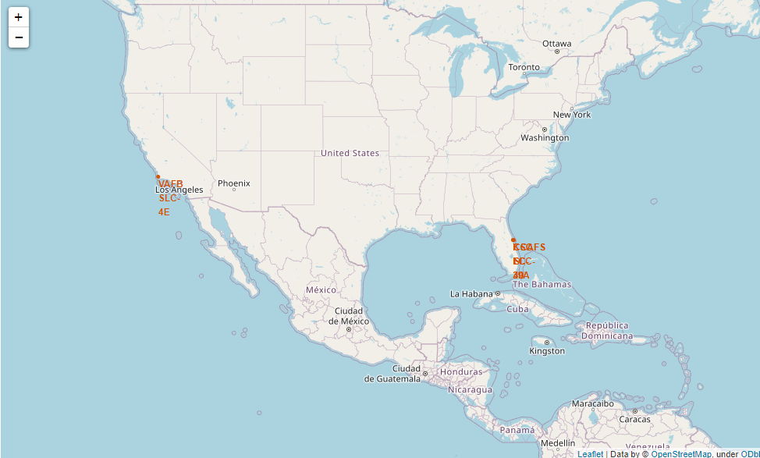
Launch Site Geo-Positions on a Global Map
All launch sites are in proximity to the Equator line?
All launch sites are in very close proximity to the coast?

Slide 36
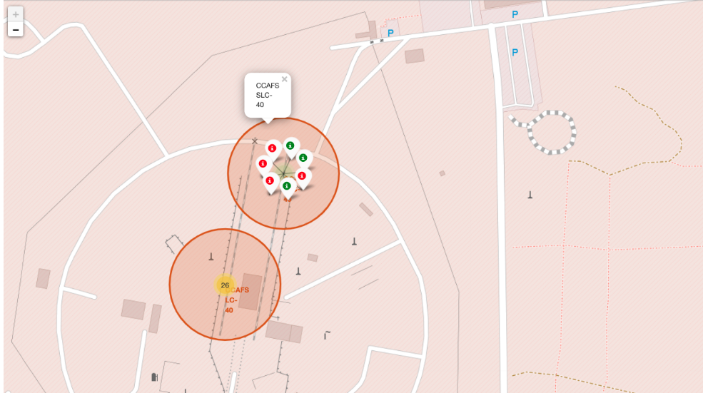
Map Showing Success Rate Per Launch Site
Launch site CCAF3 SLC 40, has a relatively moderate success rate with four successful launches to 3 failures

Slide 37
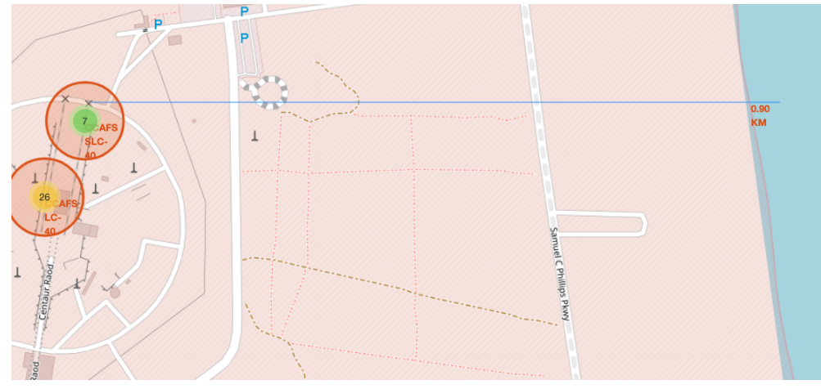
A MAP Showing Proximities Of Launch sites with Distance
From the map above we can see that the distance between launch site CCAFS SLC-40 with the coastline in 0.9KM

Slide 38

Section 4

Slide 39
SpaceX Launch Pie Chart For All Sites-Dashboard
From the pie chart, the Success count was highest in KSC LC-394 with 41.7% and lowest in CCAFS SLC -40 with 12.5%

Slide 40
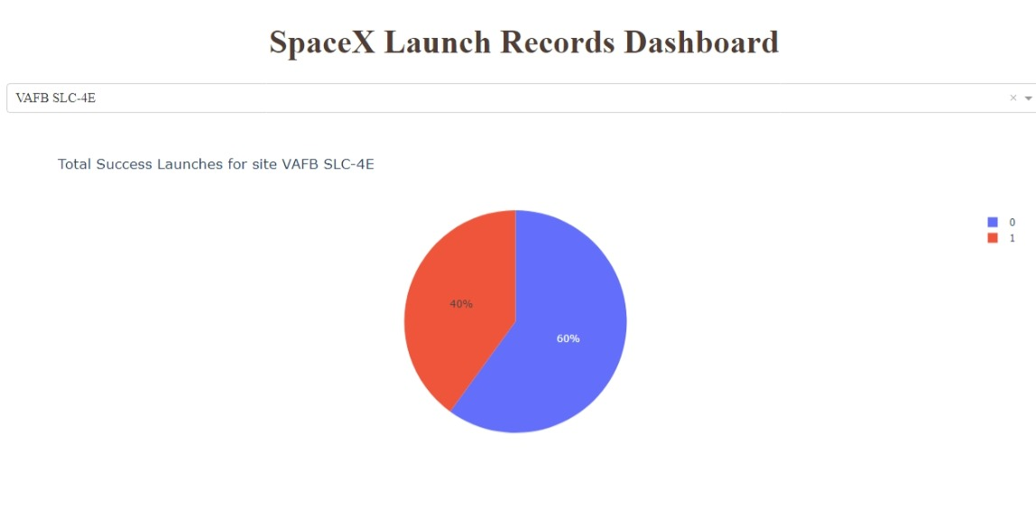
Highest Launch Success ratio Pie Chart For Launch Site
From the pie chart, VAFC SLC -4E has the highest launch success ratio with 40% success rate

Slide 41
Payload vs. Launch Outcome scatter plot for all sites
The scatter shows a variation in the points as the payload range slide is shifted from 0 to other points .

Slide 42

Section 5

Slide 43
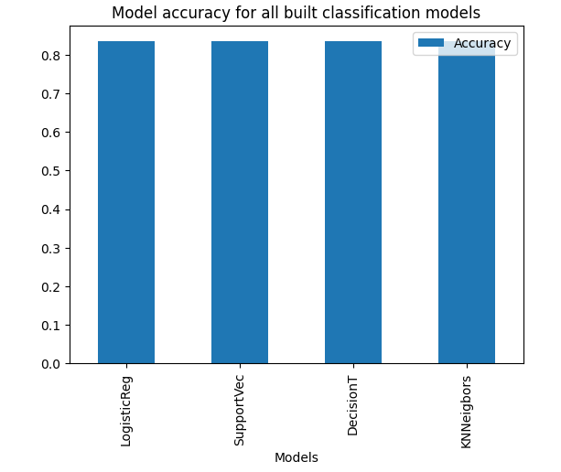
Classification Accuracy
All models had the same classification accuracy 0f 83%.

Slide 44
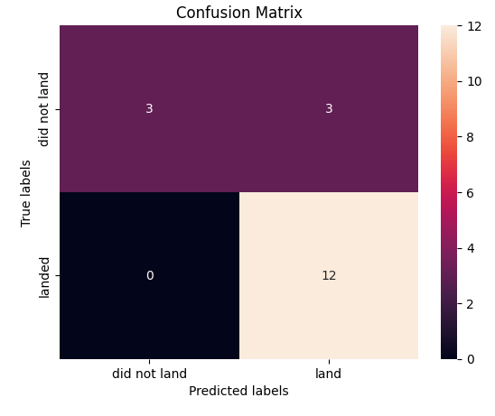
Confusion Matrix

Slide 45
Conclusions
The more the pay load mass the lower the success rate for a space mission launch
Falcons launched in the ES-L1, GEO, HEO, SSO Orbits have a high success rate
All the classifications performed well on the test data with an 83% accuracy score
The average payload mass carried by booster version F9 v1.1 is 2928.4 Kg
In the LEO orbit the Success appears related to the number of flights

Slide 46
Appendix
"https://api.spacexdata.com/v4/payloads/"+load).json()
"https://api.spacexdata.com/v4/rockets/"+(x)).json()
"https://api.spacexdata.com/v4/launchpads/"+(x)).json()
"https://api.spacexdata.com/v4/launches/past"
"https://en.wikipedia.org/w/index.php?title=List_of_Falcon_9_and_Falcon_Heavy_launches&oldid=1027686922"

Slide 47


